Slide 1


NEWZIFIER:
SGP - III PRESENTATION
GUIDED BY : ASST.PROF.BELA SHAH
21CS052 - VRAJ PRAJAPATI
21CS053 - JAY RABARI
21CS058 - AAKASH SARAIYA

Slide 2



PROBLEM DEFINITION
Sarcasm detection is the task of developing algorithms and models to automatically identify and classify sarcastic statements in textual data.
Sarcasm is a form of verbal irony where a speaker says something with the intention of conveying the opposite meaning, often in a humorous or mocking tone.
In the context of textual data, sarcasm is prevalent in social media, online forums, customer reviews, and informal communication channels.

Slide 3



WEB SCRAPING
Web scraping is the automated method of extracting information from websites. It involves using software to gather data from web pages, which can then be analyzed, stored, or used for various purposes such as research and analysis
CUSTOMERS
We have used Beautiful Soup for Web Scraping . Beautiful Soup is a Python library that simplifies the process of web scraping by providing tools for extracting data from HTML and XML documents

Slide 4


VALUES
Purpose
Sarcasm detection serves a wide range of purposes like in social media monitoring, handling customer queries and feedbacks thus enabling more accurate analysis of human communication in various contexts and enhancing the efficiency and effectiveness of human-computer interactions.
Scope
Sarcasm detection is used to figure out when people are being sarcastic, like when they say something but mean the opposite. It's helpful in understanding what people are really saying on social media, in customer service, and even for teaching language. It's like a smart tool that can catch sarcasm and help us communicate better.

Slide 5



OBJECTIVES
Objective 1
Objective 2
Objective 3
The objective of sarcasm detection is to teach computers to recognize when someone is being sarcastic in written text.
By understanding the subtleties of sarcasm, computers can respond to messages more accurately, especially in contexts like social media, customer service, and online discussions.
The objective of web scraping is to automate the extraction of valuable data from websites. It enables efficient collection of information for analysis, research, and business purposes, saving time and resources.

Slide 6

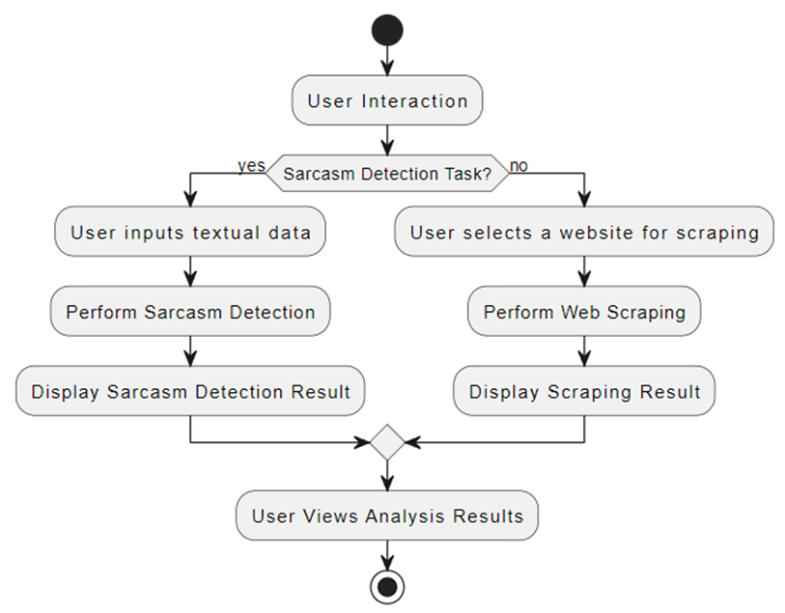
FLOWCHART

Slide 7
TECHNOLOGIES USED
01
PYTHON
02
TENSORFLOW,KERAS AND PANDAS LIBRARY
03
STREAMLIT
04
BEAUTIFUL SOUP

Slide 8
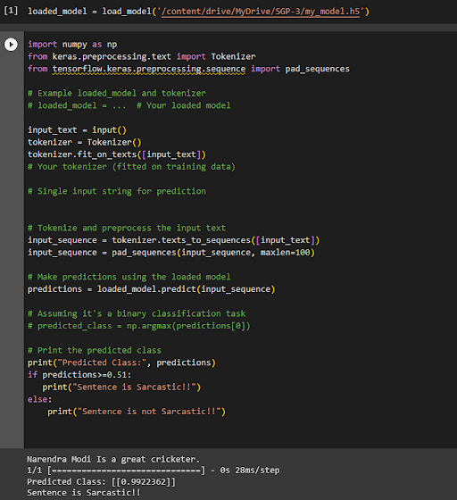
MODEL

Slide 9
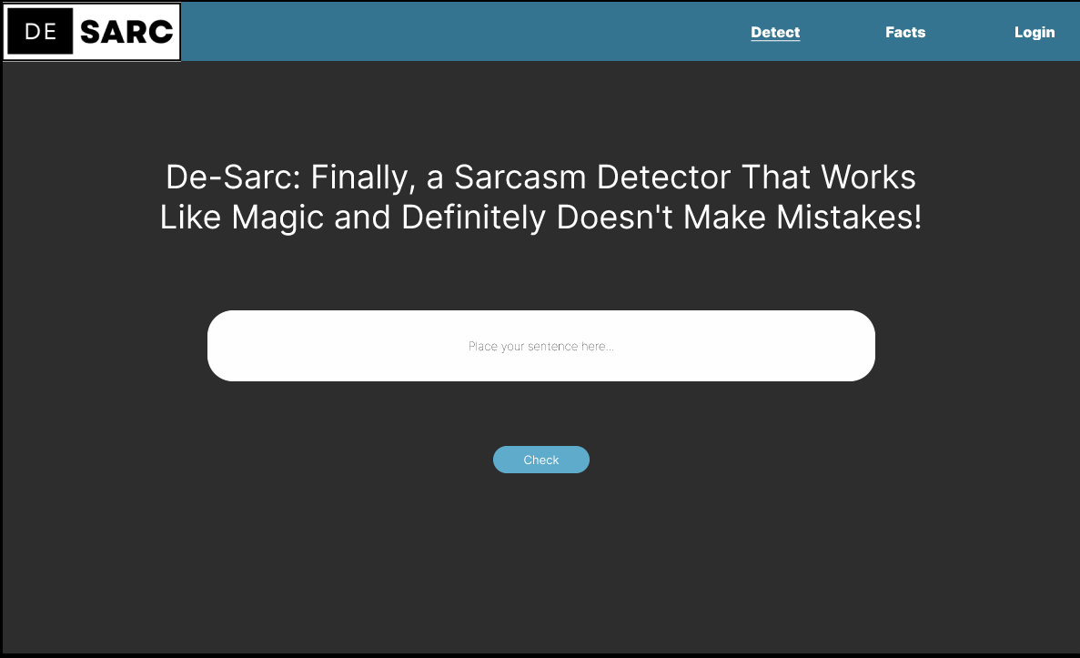
UI DESIGN

Slide 10
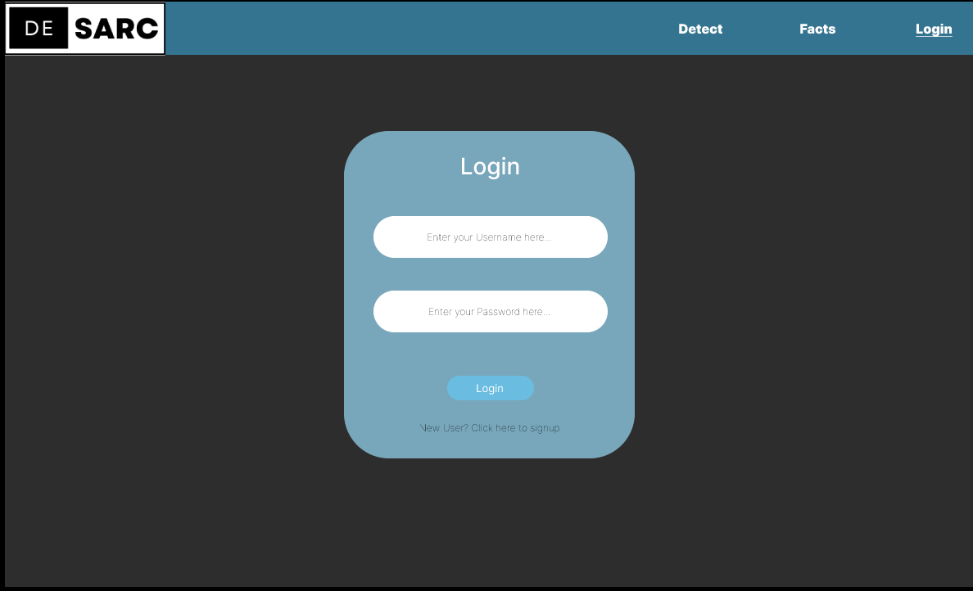

Slide 11
THANK YOU

